Slide 1
Interactively Learning Game Formulations in a Physically Instantiated Environment
James Kirk
jrkirk@umich.edu
Soar Workshop 2013
June 6, 2013

Slide 2
General Motivation
How can an agent be taught a novel problem in a real-world environment?
Sufficient specification of the problem for agent to attempt to solve
Specifically focusing on games
Long Term Goals
Robots with teachable extendable behavior
Flexible interactive instruction
Grounded knowledge acquisition
General Requirements
Effective means to communicate problem space
Problem space defines legal actions, state representation, terminal states, and goals
No policy information
Sufficient representation of problem specification
Grounding of knowledge in shared environment
Integration of perception, communication, reasoning, and action in one agent
Generality-can learn a variety of games
Ex: Towers of Hanoi, Tic-Tac-Toe, Frogs and Toads puzzle

Slide 3
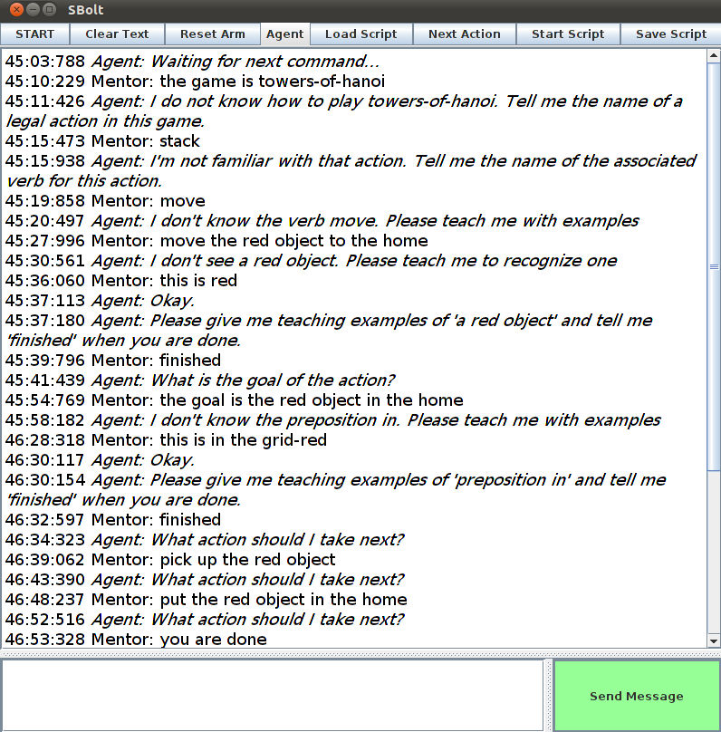
System Overview
Instructive Dialog acquires problem space almost from scratch
Starts with some primitive knowledge about:
Primitive verbs: pick-up(obj), put-down(xyz)
Primitive spatial relations: alignment along axes (ex: aligned along X axis)
Feature space knowledge of color, size, and shape
Acquires:
Verb-action knowledge (move)
Spatial prepositions (in)
Object attributes (red)

Slide 4
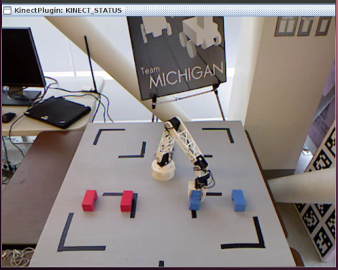

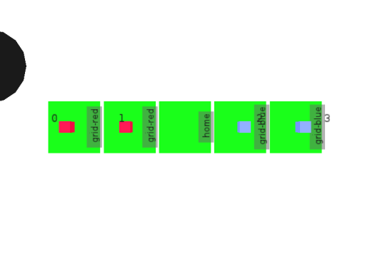
System Overview
Game
A1
Tic-Tac-Toe
P1
place
move
C1
block
location
C11
C12
Instructive Dialog to acquire problem space
and needed concepts
Game Concept Network
Interpret perception to find legal actions and internally search for goal
Manipulate environment using discovered solution

Slide 5
Shortcomings of Existing Approaches
Communication of problem space
Limited to formal languages, like C, STRIPS, or GDL
Cannot learn spatial relations for describing problem space
Do not share learned representations across multiple games
Focuses on learning through observation of game play
Representation of problem space
Problem space specifications, like STRIPS or GDL, do not ground their representations and are acquired programmatically
Require full action models and initial state descriptions
Integration
Few projects have attempted to integrate all of these components for end-to-end behavior
Knowledge must be grounded not only in perception, but across components

Slide 6
Major Contributions
A system that integrates the following components for end-to-end behavior for learning a subset of 2D grid-based games
A method for acquiring grounded concepts of spatial relationships for prepositions, which are used in communicating the problem description
The Game Concept Network (GCN)
A representation of the game, including the problem space and goal/failure states
The process to acquire the GCN through mixed-initiative structured dialog interaction
The procedural knowledge to interpret the GCN to extract necessary information from the world
A capability to internally simulate actions, search forward for the solutions, and produce action commands to manipulate the environment to achieve the goals.

Slide 7
Characterization of Games that can be Learned
Fully observable, deterministic, turn-based
Playable with discrete actions
No multi-verb actions (like replace)
Game encoded in current visual state
No rules based on history
Game state defined by
locations
spatial constraints between those locations
pieces that occupy locations
Covers many board games
Games such as Tic-Tac-Toe, Connect4, N Queens puzzle
Also games/puzzles that can be described as an isomorphism (Towers of Hanoi)

Slide 8
Major Contributions
A system that integrates the following components for end-to-end behavior for learning a subset of 2D grid based games
A method for acquiring grounded concepts of spatial relationships for prepositions
Game Concept Network (GCN)
A representation of the game, including the problem space and goal/failure states
The process to acquire the GCN through mixed-initiative structured dialog interaction
Procedural knowledge to interpret the GCN to extract necessary information from the world
A capability to internally simulate actions, search forward for the solutions, and produce action commands to manipulate the environment to achieve the goals.

Slide 9
Prepositions for Spatial Relationships
Prepositions are necessary for describing the spatial constraints of board games
Concepts must be grounded in shared representation- simulator/real-world
Basic Requirements
Learned with few examples
Cover basic prepositions between two objects in Euclidean space
SVS primitives
Axis(X,Y,Z) alignment(aligned, greater than, less than) of two objects
Distance between objects along axes
Can learn/represent prepositions such as
Left/right
Front/behind
Outside/inside
Near/far
Below/Above
Diagonal
Next to

Slide 10
Spatial relation representation
“right of”
Z
y-aligned
z-aligned
x-greater than
distance
X
Y
Other potential compositions:
“Next to”
y-aligned
z-aligned
x-(less-than or
greater-than)
distance 1.5-3
“Above”
y-greater-than
z-aligned
x-(any)
“Inside”
y-aligned
z-aligned
x-aligned

Slide 11
Spatial Projection
“Put the object to the right of the blue block.”
Use average distance information to calculate XYZ projection coordinate
Randomly selects alignment if there are multiple possible alignments along an axis
Critical for actions and for simulation
Z
X
Y

Slide 12
Major Contributions
A system that integrates the following components for end-to-end behavior for learning a subset of 2D grid based games
A method for acquiring grounded concepts of spatial relationships for prepositions
Game Concept Network (GCN)
A representation of the game, including the problem space and goal/failure states
The process to acquire the GCN through mixed-initiative structured dialog interaction
Procedural knowledge to interpret the GCN to extract necessary information from the world
A capability to internally simulate actions, search forward for the solutions, and produce action commands to manipulate the environment to achieve the goals.

Slide 13
Representing Tic-Tac-Toe
What is a sufficient representation for playing Tic-Tac-Toe?
Recognize legal actions
Place your piece (red) in an empty location
Detect Goal
Three of your pieces on the board in a line (row, column, or diagonal)

Slide 14
Acquisition of GCN
Game
M: The game is tic-tac-toe.
A: What is the name of a legal action in the game?
M: place
A: What is the verb associated with this action?
M: move
A: Tell me the name of a parameter for this action.
M: a block
A: What is a constraint for this parameter
M: the block is red
A: What is a constraint for this parameter
M: the block is not in a location
A: What is a constraint for this parameter
M: finished.
A: Tell me the name of another parameter
M: a location
A: What is a constraint for this parameter
M: the location is not in a block
action
name
A1
Tic-Tac-Toe
parameters
name
verb
constraints
P1
place
move
C1
1
2
1
2
block
location
C11
C12
spatial
attribute
spatial
S1
red
S2
prep
with
not
prep
with
not
in
location
true
in
block
true

Slide 15
Interpret Tic-Tac-Toe
Index potential objects for each parameter
Apply descriptive constraints
Apply spatial constraints
Construct full match sets

Slide 16
Simulating Tic-Tac-Toe
Visible World
Internal SVS representation
Goal Not Detected
Goal Detected!

Slide 17
Evaluation
GCN representation is sufficient to describe a variety of games
Grounded knowledge representation is sufficient for perceiving and acting in the real world
Knowledge acquisition is incremental, and transfers to other learning interactions

Slide 18
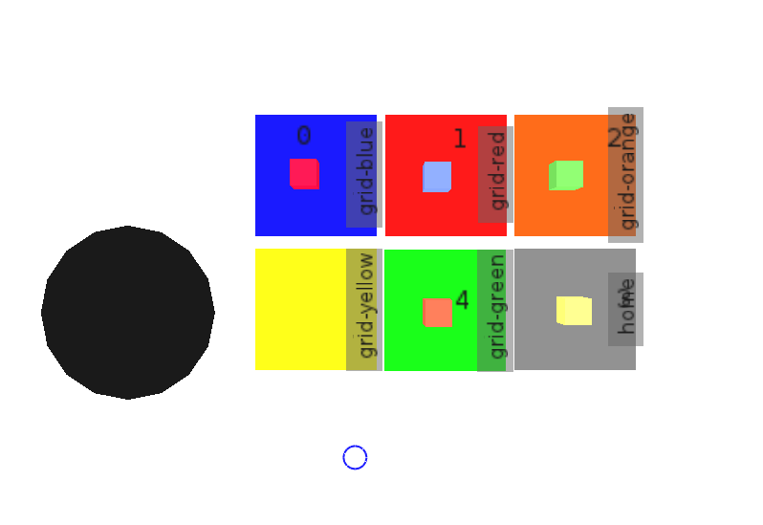
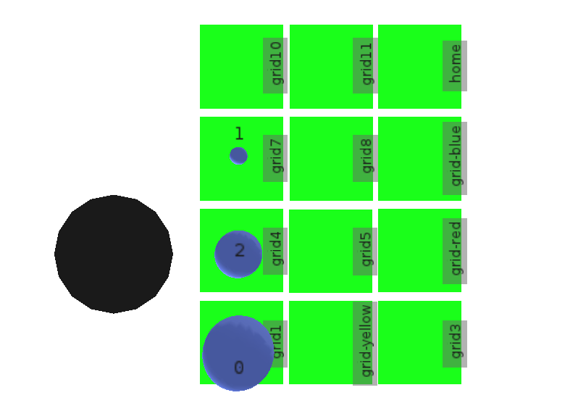

Games Learned
5-Puzzle
Towers of Hanoi
Tic-Tac-Toe
Connect-3
Bishop swap
4 Queens puzzle
Frogs and Toads puzzle

Slide 19
Concepts learned for Games
Game | Spatial-Prep(s) | Action(s) | Goal | Failure
Tic-Tac-Toe | in, linear | place | 3-in-a-row | none
Connect-3 | in, linear, above | stack, bottom-place | 3-in-a-row | none
Towers-of-Hanoi | in, above, smaller-than | shift-stack, shift-to-bottom | Right-side | none
5-Puzzle | in, diagonal, near | slide | Matching-location | none
Frogs and Toads | left of, right of, in | slide-left, slide-right, jump-left, jump-right | Side-swap | none
4 Queens | in, linear | place | All-on-board | None-attacking

Slide 20
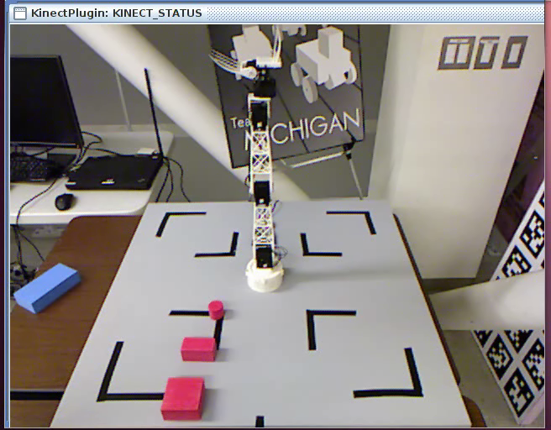
Towers of Hanoi Demo

Slide 21
Incremental Knowledge Acquisition
The interactive dialog can be long and tedious
Tediousness also do to the inflexibility of language use
Human instructional interactions can also be long/tedious
As the agent acquires knowledge of concepts, like prepositions, this interaction becomes quicker
Added additional capability to learn common concepts
For example action: place and goal: three-in-a-row
Relies on unique names for actions, goals, and failures

Slide 22
Results
Experiment: Three games taught separately and sequentially

Slide 23
Tic-Tac-Toe after Queen-4 and Connect-3
If Tic-Tac-Toe is taught last, only 5 interactions are needed!
M: the game is tic-tac-toe
A: I do not know how to play tic-tac-toe. Tell me the name of a legal action in this game.
M: place (learned in 4 Queens)
A: Ok tell me the name of another legal action in this game, or finished if no more actions.
M: finished
A: Ok tell me the name of the goal in the game.
M: three-in-a-row (learned in Connect-3)
A: Ok tell me the name of a failure state in the game. (or none)
Mentor: none
A: Ok I have now learned the basics of the game.

Slide 24
Nuggets and Coals
Nuggets
Can learn and play many different games
Works in real world environment
Concepts transfer between games
Coals
Limitations in object permanence, preposition learning, verb learning
Currently limited to 2-Dimensional board games
Iterative deepening insufficient for handling many games/puzzles

Slide 25
Questions?

Slide 26
References
Barbu, A.; Narayanaswamy, S.; and Siskind, J. M. 2010. Learning physically-instantiated game play through visual observation. In Proc. of ICRA’10, 1879–1886.
Genesereth, M., and Love, N. 2005. General game playing: Game description language speciﬁcation. Technical report, Computer Science Department, Stanford University, Stanford, CA, USA.
Genesereth, M. and Love, N. General game playing: Overview of the AAAI competition. AI Magazine, 26(2), 2005.
Hinrichs, T., and Forbus, K. 2009. Learning Game Strategies by Experimentation. Paper presented atthe IJCAI-09 Workshop on Learning Structural Knowledge from Observations. Pasadena, CA, July 12.
Kaiser, Ł. Learning Games from Videos Guided by Descriptive Complexity. In Proceedings of the 26th Conference on Artificial Intelligence, AAAI-12, pp. 963–970. AAAI Press, 2012.
Laird, J. (2012). The Soar cognitive architecture. Cambridge, MA: MIT Press.
Mohan, S., Mininger, A., Kirk, J., & Laird, J. (2012). Acquiring Grounded Representation of Words with Situated Interactive Instruction. Advances in Cognitive Systems.
Roy, D. (2005). Grounding words in perception and action: computational insights. Trends in Cognitive Sciences, 9, 389–396.
Thielscher., M. A general game description language for incomplete information games. In Proc. of AAAI, 994–999, 2010.
Thielscher, M. 2011a. The general game playing description language is universal. In Proceedings of IJCAI.
Thielscher, M. (2011). General Game Playing in AI Research and Education. In J. Bach & S. Edelkamp (Eds.), Proceedings of the German Annual Conference on Artiﬁcial Intelligence (KI) (Vol. 7006, pp. 26–37). Berlin, Germany: Springer

Slide 27
Extra slides

Slide 28
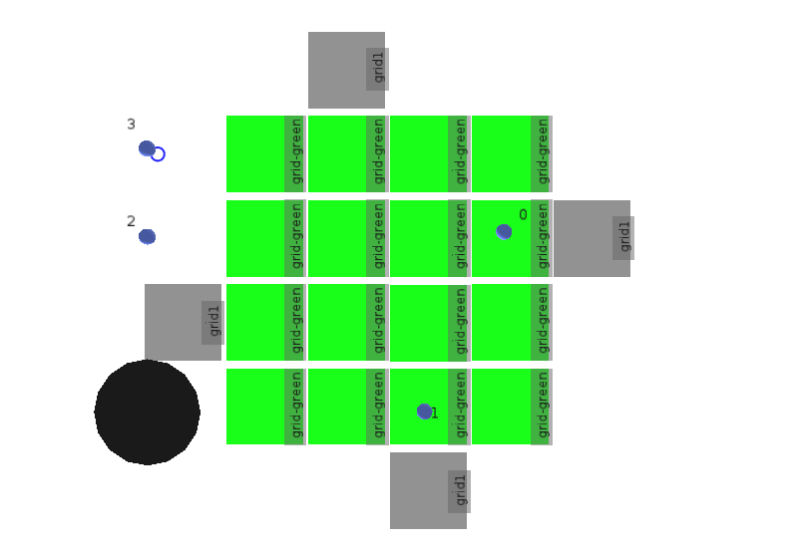
N Queens Game
4 Queens puzzle: Place each queen(blue object) on the board so that none are attacking. Border locations reduce specification complexity.

Slide 29
5 Puzzle
5 puzzle: Slide pieces so that they end in their matching location (here: color). Can express adjacent relationship for slide action with multiple prepositions.

Slide 30
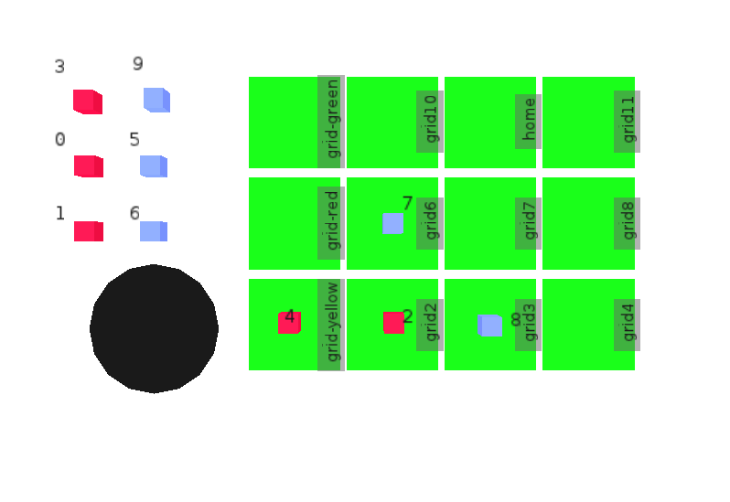
Connect-3
Connect-3: Another game described with an isomorphism like Towers of Hanoi

